Slide 1
Course: Programming Fundamentals
4.00 Credit Hours, Fall 2018,
Graduate Program
Instructor: Maryam Ehsan

Slide 2
Today’s lecture outline
Function call by address or pointer
Function return value
Recursive functions

Slide 3
Function Calls
Arguments can generally be passed to functions in one of the two ways:
sending the values of the arguments
sending the addresses of the arguments

Slide 4
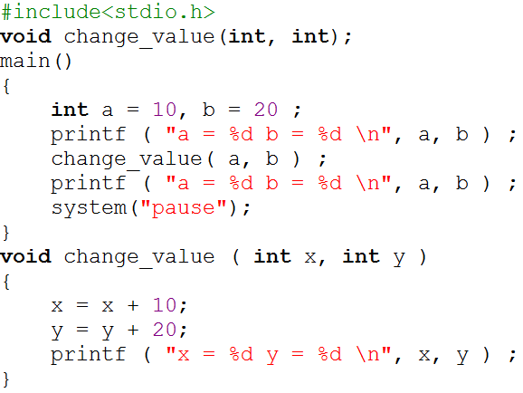
Example program 1 – function call by value
Memory
main()
a
10
b
20
6504
7505
change_value()
x
20
10
y
40
20
3205
4350
Program Output
a = 10 b = 20
x = 20 y = 40
a = 10 b = 20
Press any key to continue …

Slide 5
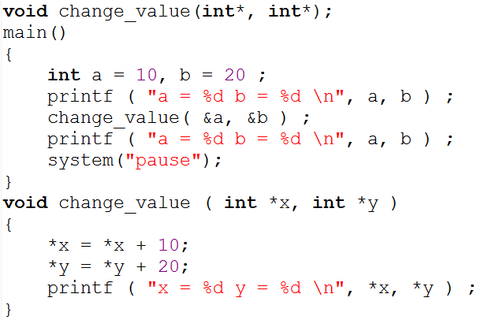
Example program 1 – function call by address
Memory
change_value(6505, 7505);
main()
a
10
20
b
40
20
6504
7505
change_value()
*x
6504
*y
7505
3205
4350
Program Output
a = 10 b = 20
*x
=*(6504)
= 10
x = 20 y = 40
a = 20 b = 40
Press any key to continue …

Slide 6
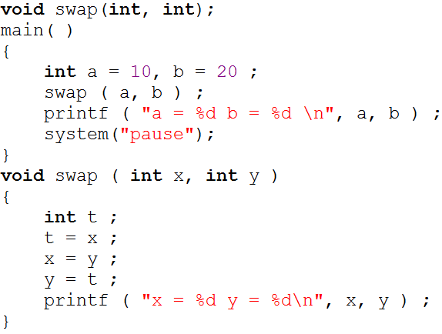
Example program 2-function call by value

Slide 7
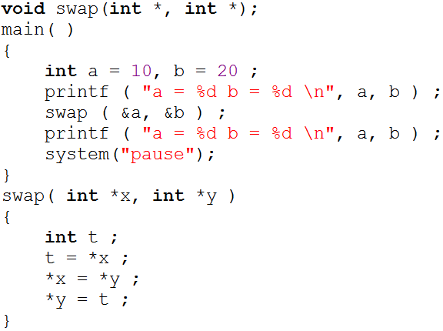
Example program 2-function call by address

Slide 8
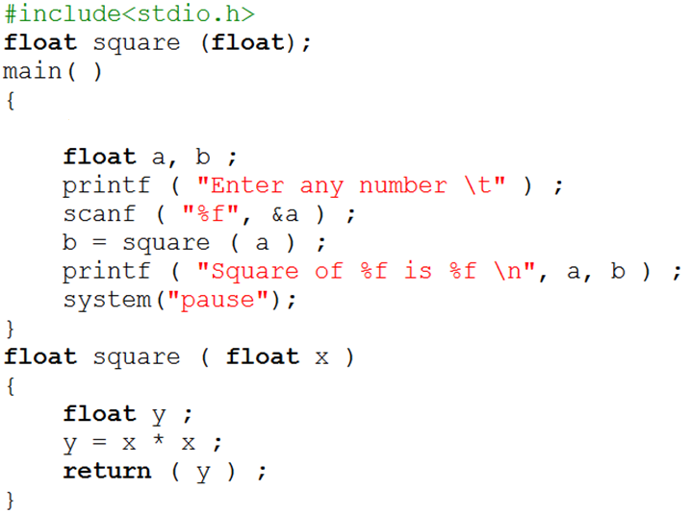
Return value of a function

Slide 9
Points to remember
Passing arguments by value is not the most efficient means for programming in C/C++
When arguments are passed by value, the called function is unable to modify the original contents of the incoming parameters
When arguments are passed by address, the called function is able to modify the original contents of the incoming parameters
A function only return a single value

Slide 10
Conclusion
If we want that the value of an actual argument should not get changed in the function being called, pass the actual argument by value.
If we want that the value of an actual argument should get changed in the function being called, pass the actual argument by reference.
If a function is to be made to return more than one value at a time then return these values indirectly by using a call by reference.

Slide 11
Recursive function
In C/C++, it is possible for the functions to call themselves
A function is called ‘recursive’ if a statement within the body of a function calls the same function

Slide 12
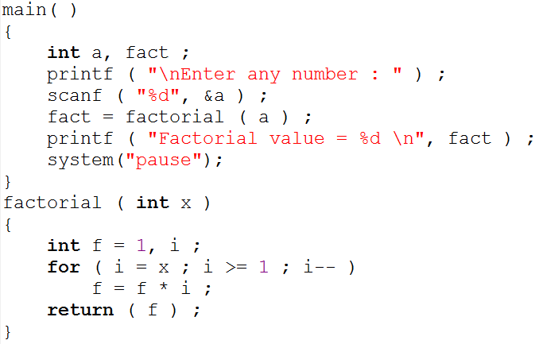
Example program - factorial

Slide 13
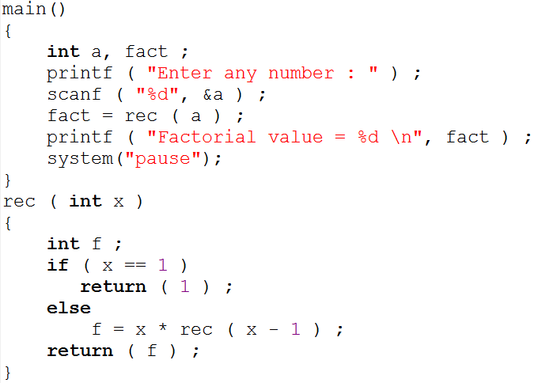
Example program – factorial using recursion

Slide 14
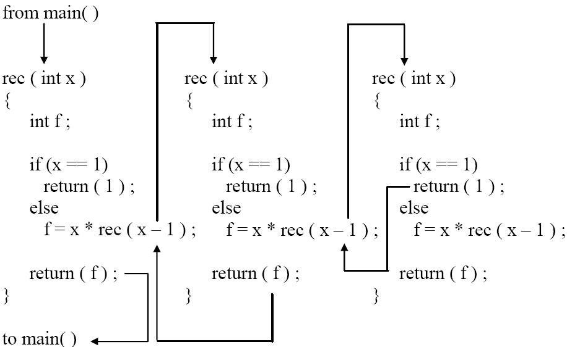
Cont.

Slide 15
Cont.
main()
{
….
….
fact = rec(3);
printf ( "%d ", fact);
}
rec ( 3 )
{
int f ;
if ( 3 == 1 )
return ( 1 ) ;
else
f = 3 * rec ( 3 - 1 ) ;
return ( f ) ;
}
rec ( 2 )
{
int f ;
if ( 2 == 1 )
return ( 1 ) ;
else
f = 2 * rec ( 2 - 1 ) ;
return ( f ) ;
}
false
false
rec ( 1 )
{
int f ;
if ( 1 == 1 )
return ( 1 ) ;
else
f = 2 * rec ( 2 - 1 ) ;
return ( f ) ;
}
f = 3 * 2;
f = 6
f = 2 * 1;
f = 2
true
fact = 6

Slide 16
Example program 2
Write a definition of a function that adds n integers using recursion and then return the sum. Prototype of the function is below
int sum_number(int);

